Slide 1
Competing Utilitarian Proposers Self Evolutionary Consensus Algorithm (CUPSEC) Test Results ( Resumé)

Slide 2
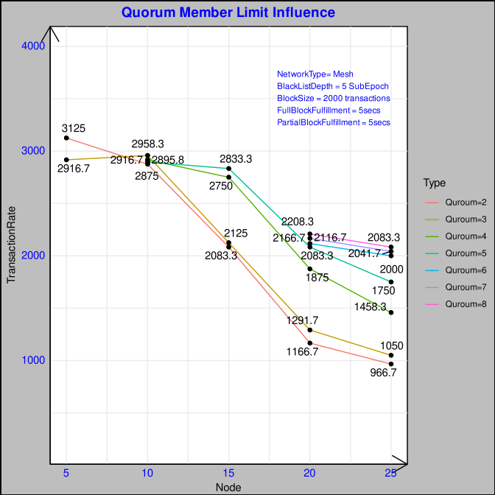
CUPSEC Quorum Member Limit Influence
Consensus takes place in 2 phases:
1) Intra-Quorum Consensus communication for Partial Block [PROPOSE, COMMIT, FINALISE]
2) Inter-Quorum communication for Full Block
Increase in Quorum can increase the partial block parallelization.
Also more Quorum size can decrease the no of intra quorum message communication as inter-quorum is constant complexity at O(1) lower bound and O(2) at upper bound incase of full block fulfiller.
Eg in case of only COMMIT message:
No of Nodes: 20
Case 1: Quorum = 2
Q₁ = 10 | Q₂ = 10
Minimum majority for IntraQuorum = 2/3
==> Q_{n} (majority) = 7
M = Total Majority of Members in Quorum
Intra Quorum Communication = M* (M-1) * No of Quorums
= 7 * 6 * 2 = 84
Case 2: Quorum = 5
Q₁ = 4 | Q₂ = 4 | Q₃ = 4 | Q₄ = 4 | Q₄ = 4 |
Minimum majority for IntraQuorum = 2/3
==> Q_{n} (majority) = 3
M = Total Majority of Members in Quorum
Intra Quorum Communication = M* (M-1) * No of Quorums
= 3 * 2 * 5 = 30 (2.8 time gain due to increase of quorum)
But Quorum members has to be optimal considering the faulty nodes/ adverse probability affecting liveness

Slide 3
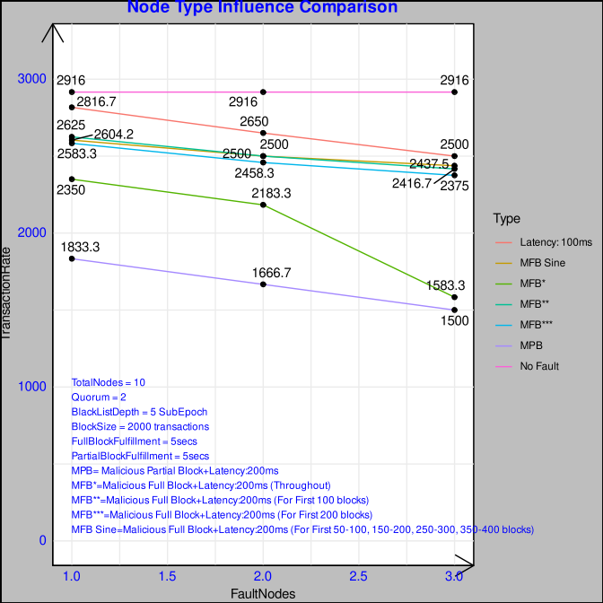
CUPSEC Fault Node Influence
In this test type we introduce 4 types of conditions:
Each case varies with 1,2,3 Nodes in a total of 10 Nodes with 2 Quorums.
Case 1: Latency of 100ms in message communication
Case 2: Malicious Full Block in which signature is falsified with block contents modified and broadcasted along with 200ms latency in communication
Case 3: Malicious Partial Block in which signature is falsified with block contents modified and broadcasted along with 200ms latency in communication.
Case 4: No Fault or Adverse case.
Partial Block Malicious Activity decreases the performance to a much extent than the full block as it slows at the level of ephemeral chain which is detected and the malicious score is increased.
In case of Full Block there is a Fulfiller which runs at 5 secs in case the block is not finalised but in case of a partial block fulfiller the malicious actors inside a quorum has more probability to be chosen as the proposer within a limited set of nodes.
Beyond 3 malicious nodes the network cannot handle as thse total nodes is 10
Case 5: Malicious Full Block + Latency 200ms for 100 blocks or 4 Subepochs
Case 6: Malicious Full Block + Latency 200ms for 200 blocks or 8 subepochs
Case 7: Malicious Full Block + Latency 200ms in sine wave pattern

Slide 4
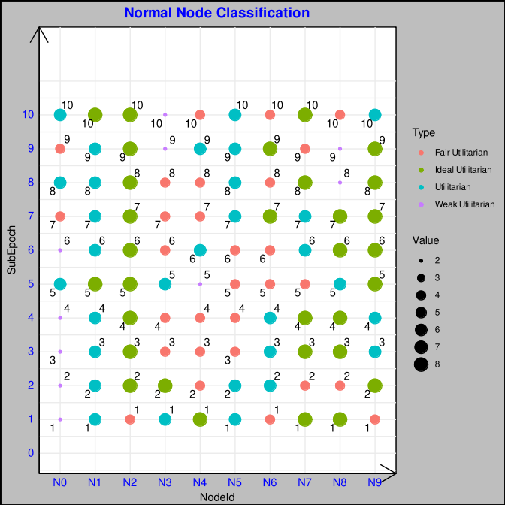
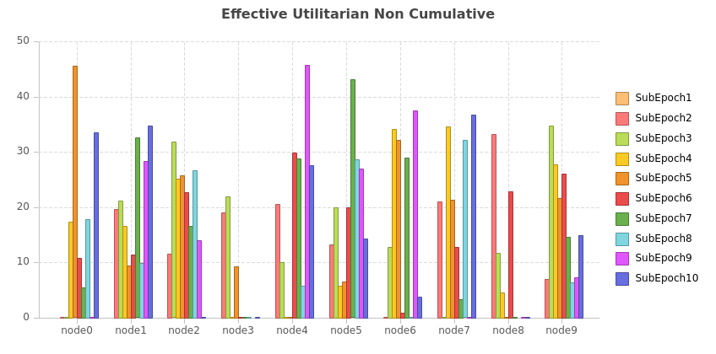
CUPSEC Normal Node Behaviour
Utilitarian Classification | Ideal Utilitarian | Utilitarian | Fair Utilitarian | Weak Utilitarian
Fairness Coefficient (Additive Factor) | 0 | 0.05 | 0.1 | 0.15
Non Cumulative Effective Score ( Representation for Each SubEpoch) = Positive Utilitarian Behaviour – Negative Utilitarian Behaviour
Node 3 , Node 8 – Faulty Behaviour
Their Utilitarian Sortition lands Node3 – Weak Utilitarian | Node 8 – Fair Utilitarian
Node 0 is in intitial Weak Utilitarian phase but ascends to Utilitarian Classification
Node 3 is in Utilitarian phase but descends to Weak Utilitarian
Node4 has a utilitarian lifecycle from Ideal Utilitarian → Fair Utilitarian → Utilitarian → Fair Utilitarian
Node7 has a utilitarian lifecycle from Ideal Utilitarian → Fair Utilitarian → Utilitarian → Fair Utilitarian
Node8 has a utilitarian lifecycle from Ideal Utilitarian → Fair Utilitarian → Ideal Utilitarian →Utilitarian → Ideal Utilitarian → Weak Utilitarian → Fair Utilitarian

Slide 5
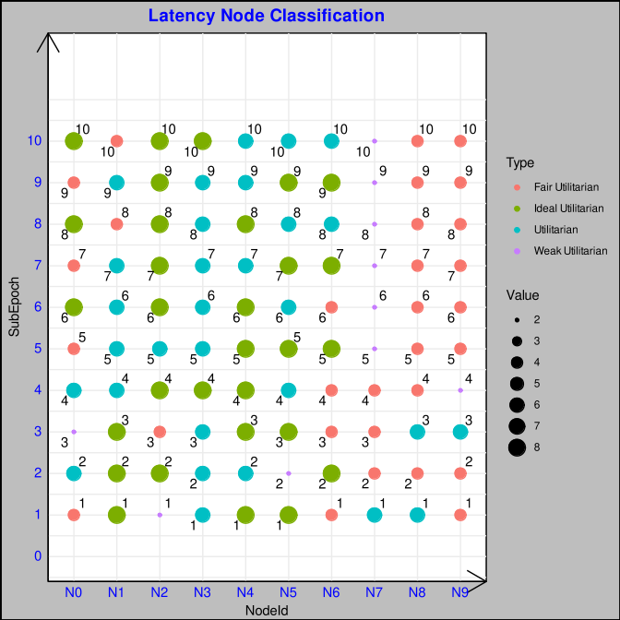
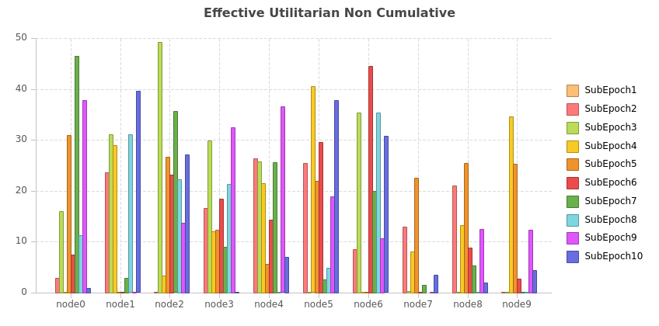
Utilitarian Discussion of Latency Node
Node 7 is suspended as due to latency action and Node 8,9 fall in the last classification of Fair Utilitarian inspite of fairness as they continue their adverse behavior
Also the non cumulative effective score of Node 7,8,9 is low
Fairness Coefficient is not relevant for Node7,8,9 as its conscious behavior
Node 2 ascends from weak to ideal, Node 1 descends from ideal to fair which is quite fair.

Slide 6
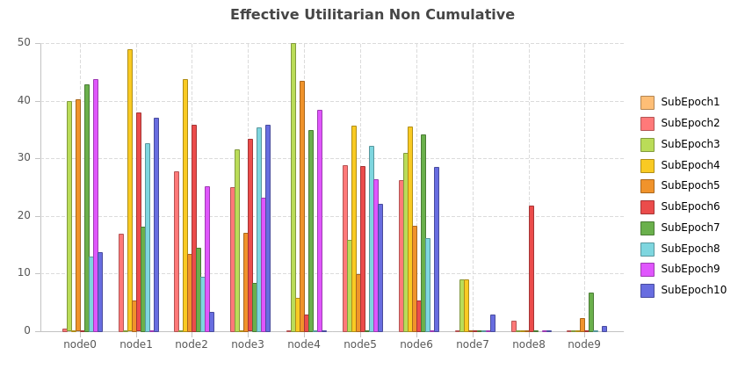
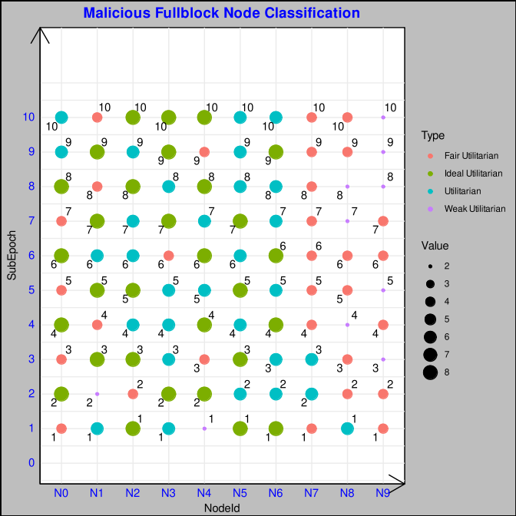
CUPSEC Malicious Node Behavior: Full Block +200ms Latency
Effective Score Non Cumulative is quite low for the
malicious nodes Node7,8,9 as expected.
But observation for for Node 1,2 and 4 also is affected which is due to the missed partial block and commit score in the negative action which is not deliberate. Suspension : SubEpoch7: Node 8 | SubEpoch8: Node 9.
Fairness in classification:
Node 0 and Node 4 is able to progress from Fair Utilitarian and reaches Utilitarian
While Node 1 diminishes due to sustained inadvertent missed partial block and commit score.

Slide 7
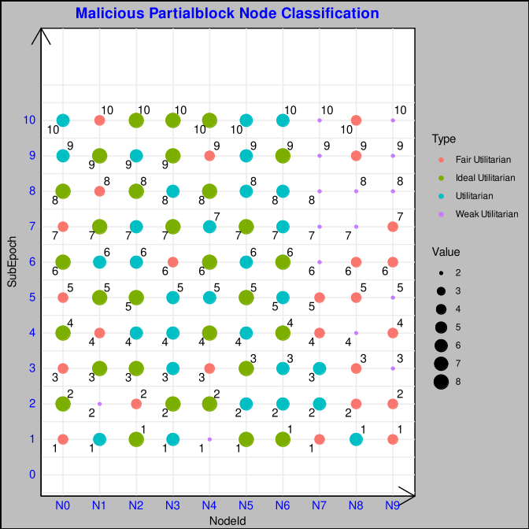
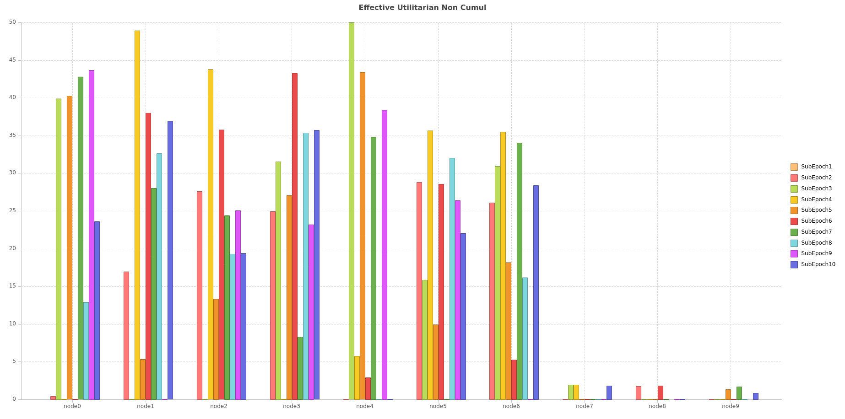
CUPSEC Malicious Node Behavior: Partial Block +200ms Latency
Effective Utilitarian Non Cumulative is low for Node 7,8,9 nodes as explained by malicious partial block.
Classification of Node7,8,9 hovers between Fair Utilitarian and Weak as they are not able to recover from malicious action.
While Node 4 progresses from a Weak Utilitarian to Ideal Utilitarian, Node 0 moves from Fair to Ideal and finally to Utilitarian exhibiting fairness in the algorithm.

Slide 8
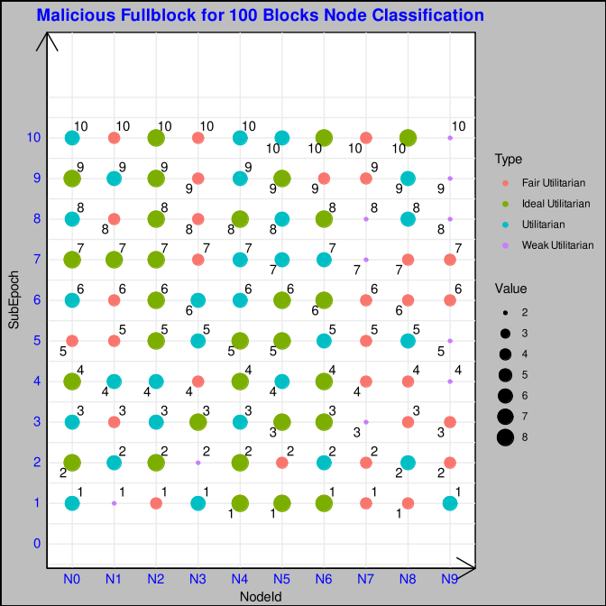
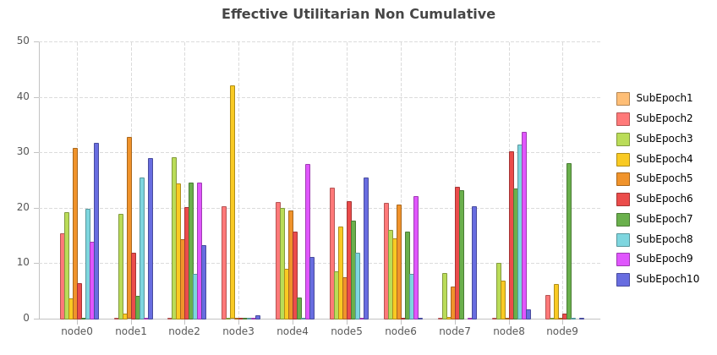
CUPSEC Malicious Node Behavior: Full Block + Latency: 200ms [First 100 blocks]
Node 7, 8, 9 start out good initially but due to the initial malicious behaviour it falls withing the range of Fair or Weak Utilitarian
Node 1 is inadvertently in weak and Node2 as Fair but continues to progress through the ranks and settles as Fair and Ideal.
At SubEpoch 7: Node 7 is suspended
At Subepoch 8: Node 9 is suspended. Suspension Depth is at 5 to keep optimal, so the intitial malicious behaviour is affecting at subepoch 7. This is in general to keep fairness to give a chance for at least 5 subepochs. But the detection of the malicious block optimises the network.

Slide 9
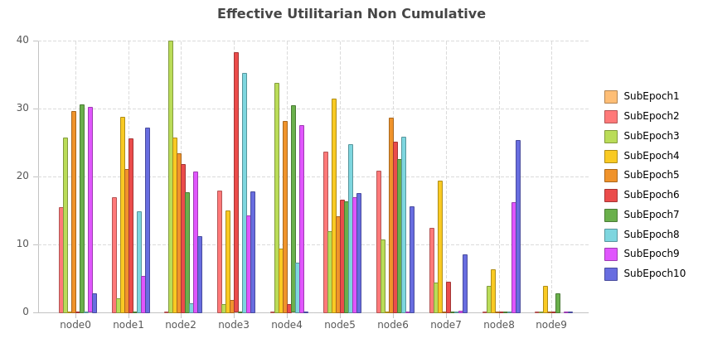
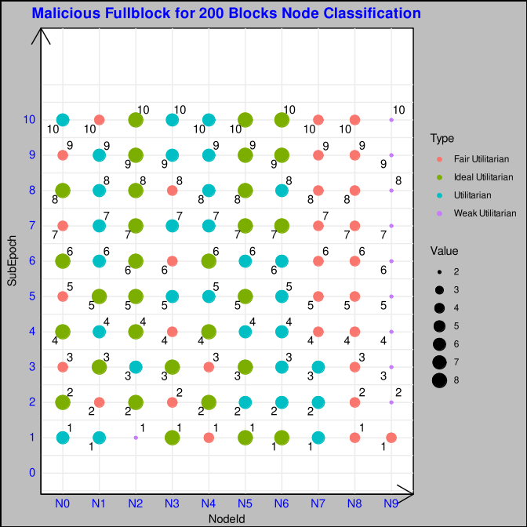
CUPSEC Malicious Node Behavior: Full Block + Latency: 200ms [First 200 blocks]
Suspension: SubEpoch7: Node 9
Node 7,8 and 9 is hovering between Fair and Weak Utilitarian.
Node 9 is suspended which optimises the network as the malicious member doesnt participate in the consensus.
Node 2 and 4 on the other hand progresses from weak and fair respectively to Ideal Utilitarian and Utilitarian

Slide 10
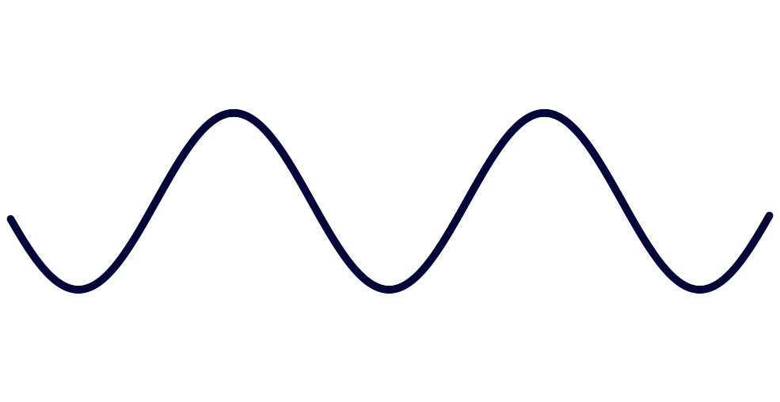
CUPSEC Malicious Node Behavior: Full Block + Latency: 200ms [50-100, 150-200, 250-300, 350-400]
In this test the Nodes behave maliciously intermittently at repeated intervals similar to a pattern of Sine Wave
So there is a period of transaction drop and then optimisation follows which makes the network to be resilient and suspend the malicios nodes to path of restoration.
Malicious:50 - 100
Malicious:150 - 200
Normal:0 - 50
Normal:100 - 150
Normal:250 - 300

Slide 11
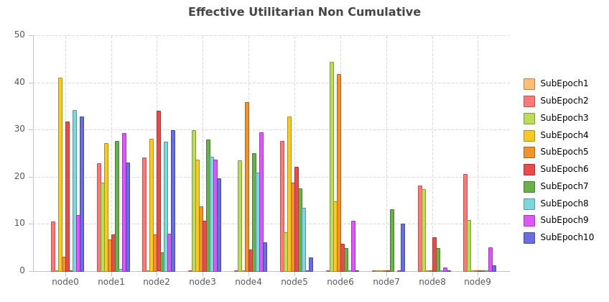
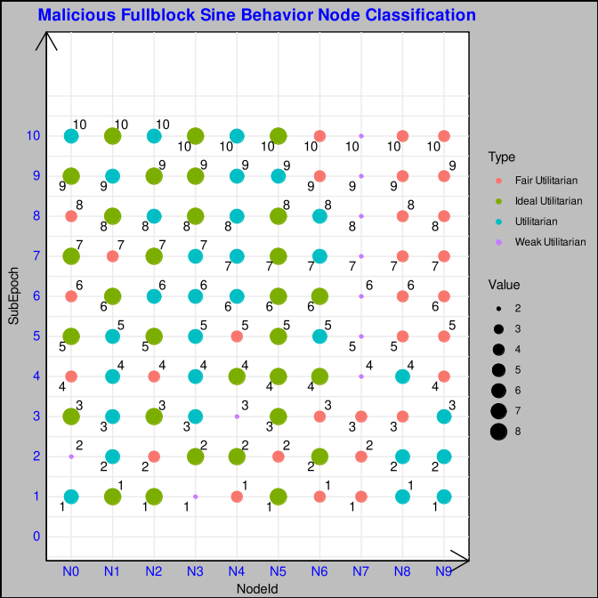
CUPSEC Malicious Node Behavior: Full Block + Latency: 200ms [50-100, 150-200, 250-300, 350-400]
Effective Utilitarian non cumulative as evident by its
behaviour is low but since its non cumulative we see a
Sinusoidal pattern in its score.
Suspended Nodes:
SubEpoch 7: Node 7
Node 7 is suspended and Node 8,9 will follow suit as it lies in the lower slab of fair utilitarian

Slide 12
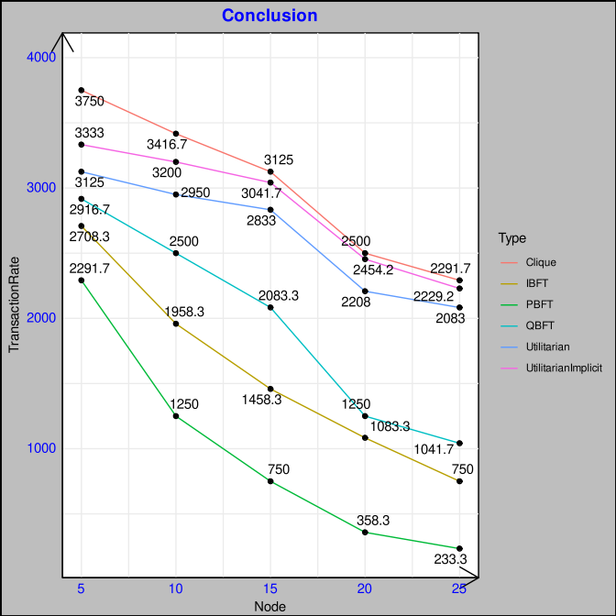
Overall Comparison Transaction Rate and Scalability
Overall comparison of consensus algorithms simulated:
Clique: It shows a smooth gradient drop with respect to scalability as discussed earlier but is not steep as it is more of block proposal broadcast rather than majority votes for multiple phases of consensus.
PBFT: With 4 phases of Pre-Prepare,Prepare,Commit and Round Change plus the N*(N-1) for each phase augments the message complexity load bringing down the transaction rate.
IBFT: It is a lighter version of PBFT with Prepare, Commit and Round Change which is better but suffers due to block locking.
QBFT: Similar to IBFT but without blocklocking scales better.
Utilitarian: For 5,10 Nodes compared to 15,20 and 25 it improves the parallelization factor. It shows a Z shaped plot which ascends until 15 Nodes for 6 Quorums which is a balance between IntraQuorum and InterQuorum Message but at the same quorum membership for 20, 25 Nodes it augments the intraquorum communication.
Ideal Quorum Membership is necessary to balance between IntraQuorum, Security and Liveness Factor
Utilitarian Implicit: It is a more lighter form of Utilitarian and performs slightly better than it with one reduced phase Finalise compared to Prepare,Commit,Finalise.

Slide 13
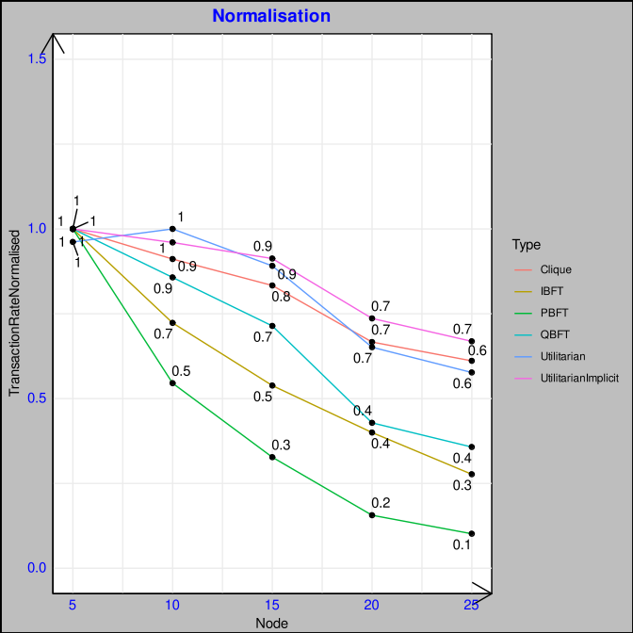
Overall Comparison: Normalisation
Normalisation is calculated by the maximum transaction rate for each consensus.
Normalisation Comparison between simulated and actual binary show a similar behaviour which exhibits an almost smooth convex curve for PBFT,IBFT signifying scalability drop. It is a rugged concave for QBFT,Clique.
Normalisation shows Z shape for Utilitarian, Utilitarian Implicit, it can be inverted V for more optimised quorum membership but can affect the fault tolerance, liveness and safety property.

Slide 14
Overall Comparison: Scalability
In looking from a scalability perspective, PBFT shows wide gradience due to its multiplying communication complexity with all the nodes combined with multiple phases of consensus.
Clique gradience is quite smooth as its more of a proposal and acceptance without acknowledgement by its participants which is the root cause of forks.
IBFT as is more gradual with lesser phases compared to PBFT and increasing a bit with more nodes.
QBFT is very minimal in initial threshold upto 15 nodes and then a steep rise in scalability drop is obtained as risen by the phases and message complexity
In Utilitarian it is more comparable with QBFT when after 15 nodes we notice a drop but it is less than the former. Its combination of Intra-Quorum and Inter-Quorum reduces the message communication complexity.
Also the presence of utilitarian score helps in optimisation and reorganisation of the network drooping malicious nodes. It regains the nodes on its restoration or recovery to good behaviour ensuring fairness of opportunity.

Slide 15
Overall Comparison: Fault
Fault Throughout presents a more drastic drop as the nodes are more of not in recovery but intend to bring the transaction rate.
Since in this case both common to MFB and MFB, suspending the members upto 3 reduces fault tolerance which reduces the transaction rate.
In other case of intermittent malicious behavior the scalability drop is not quite high, it has a recovery path.

Slide 16
Conclusion
In ideal Quorum to Member ratio the Utilitarian shows a more acceptable scalability conditions with the recovery due to quorum optimisation at the end of each subepoch
In the case of inadvertent faults (not conscient) the network can reorganize and ensure the performance of the network.
In case of advertent behaviour as discussed earlier the nodes can ensure resilience but ensuing suspension of nodes should be offset by adequate remaining nodes to ensure liveness.
It avoids forks and resilient to faulty or malicious behaviour avoiding round change or forks in worst case.

Slide 17
Feedback
M . Verdier:
Hashing: Cite more and verify the performance
Langage de Development: Rust
Mesh --> Change to Full Connected Mesh
Scalability Gradient -→ ?? To Change, Not Representative
PBFT Nature Article : To discuss in grand detail and verify if there are any corrections.
Optimum Quorum No? How and What?
Profondément Etudier – SubEpoch Change – Explain well?
To Look:
https://www.mdpi.com/2076-3417/11/20/9372
A Coordination Technique for Improving Scalability of Byzantine Fault-Tolerant Consensus
https://www.researchgate.net/publication/346520550_A_Scalable_Multi-layer_PBFT_Consensus_for_Blockchain

Slide 18
Pointers
Transaction Ordering
Election Manipulation
Fork Discussion
Attack Scenario & Profit Strategy
Scenario: ?? Resiliency, Optimization,Evolution Behaviour ( Initial: Malicious and Later: Recover)
Can we use the score to give a fair chance to propose a block/partial/quorum or that limits the opportunity too much in a consortium? (Fairness vs security perspective vs liveness argument vs Fault Tolerance)
Latency vs Faulty

